Slide 1
A46 Expressway Road to Ruin
Gerald Kells, Strategic Policy and Campaigns Advisor

Slide 2
Housing
The Environment
Transport
Gerald Kells, Strategic Policy and Campaigns Advisor

Slide 3
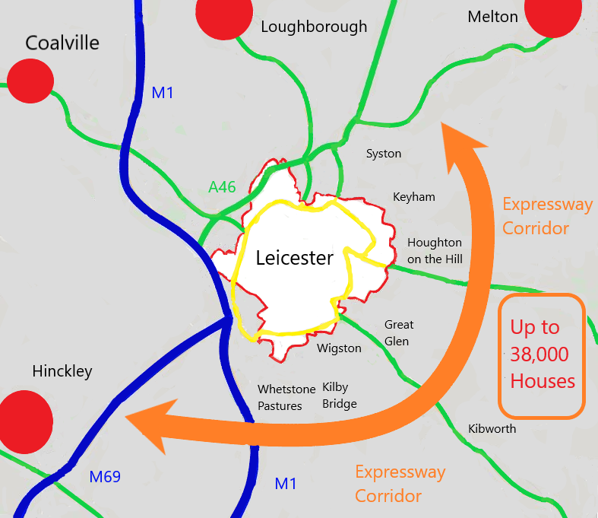
The Leicestershire Proposals
Gerald Kells, Strategic Policy and Campaigns Advisor

Slide 4
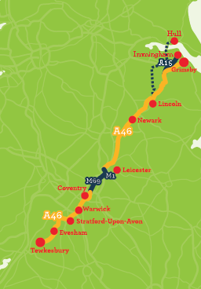
Leicestershire
Potential for
Leicester Southern/Eastern bypass
M1 Smart Motorway
Upgrading
Leicester
Western bypass
Improving Hobby Horse interchange at Syston
The Midlands Connect Idea
Gerald Kells, Strategic Policy and Campaigns Advisor

Slide 5
Housing Need
The Level of Housing Need is Exaggerated in the Strategic Growth Plan
Latest Forecasts show Leicester needing a little more than half the amount of new housing in the next 20 years
Gerald Kells, Strategic Policy and Campaigns Advisor

Slide 6
Housing Supply
Lack of up to date information on housing land in Leicester
Gerald Kells, Strategic Policy and Campaigns Advisor

Slide 7
Housing Supply
We believe:
Leicester can supply more housing on
Brownfield and Windfall Sites
Other towns should be targeted for regeneration such as Coalville
Gerald Kells, Strategic Policy and Campaigns Advisor

Slide 8
The Environment
Put Value on High Leicestershire Countryside
Seek to reduce traffic
Seek to regenerate Urban Areas
Seek to address Climate Change
Gerald Kells, Strategic Policy and Campaigns Advisor

Slide 9
The A46 Transport Issue
Congestion driven by access to Leicester
Congestion a Network Problem
Congestion a Peak Time Problem
Congestion a Problem on Local Roads
Gerald Kells, Strategic Policy and Campaigns Advisor

Slide 10
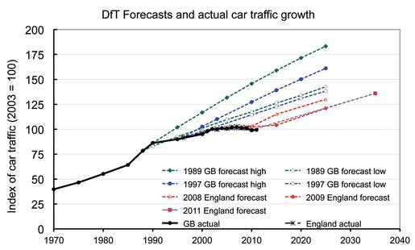
Future Traffic Growth is Exaggerated
Gerald Kells, Strategic Policy and Campaigns Advisor

Slide 11
What the Expressway Would Do?
Generate Additional Traffic
Create Congestion on Routes from the East/South of Leicester
Gerald Kells, Strategic Policy and Campaigns Advisor

Slide 12
The Through Traffic Myth
Less than 20% of traffic on the A46 is through traffic
(Even less in the peaks)
Less than 10% of that is HGVs.
Removing some of that traffic would increase local traffic on the route
That would reduce the A46s traffic capacity and generate congestion on roads into Leicester
Gerald Kells, Strategic Policy and Campaigns Advisor

Slide 13
Five Stage Transport Approach to Problem
Get rid of Expressway
Invest in Public Transport to access Leicester
Consider Demand Management measures in Leicester
Invest in specific interventions on the existing A46 (as a stop gap)
If needed support those with small-scale road capacity additions
Gerald Kells, Strategic Policy and Campaigns Advisor

Slide 14
Detailed Briefing
http://www.cpreleicestershire.org.uk/
E-mail: info@cpreleicestershire.org.uk
Gerald Kells, Strategic Policy and Campaigns Advisor

